Slide 1
Chapter 2
Presentation of Data

Slide 2
Introduction
A manager encounters data every day and until the manager puts in some effort to shape the data, its remains scattered . Drawing conclusions from raw data is very difficult .
Raw data is technically called the ungrouped data. Data presented in the form of frequency distribution is called grouped data. Once data is grouped it conveys message to the reader and on the basis of it, decision making becomes easier.

Slide 3
The device of gathering data often results in a massive volume Of statistical data which are in the form of individual measurement or count. It is difficult to learn anything by examining the unorganized data which is more often confusing and condensed into a form that can be more rapidly and easily understood and interpreted.
For this purpose techniques of classification tabulation and graphic displays are presented in this chapter.
Classification
The process of arranging data into classes or categories according to some common characteristics present in the data is called classification.

Slide 4
Types of classification
One way classification
When data are classified by one characteristics , then it is said to be one way classification.
Two Way classification
When data are classified by two characteristics, then it is called two way classification.
Aims of classification
To reduce the large set of data to an easily understood summary .
To display the point of similarity and dissimilarity.
To save mental strain by eliminating unnecessary details.
To reflect the important aspects of the data.
To prepare the ground for comparison and inferences.

Slide 5
Tabulation
The process of arranging data into rows and columns is called tabulation. Tabulation may be simple, double or complex depending upon the type of classification.
Types of tabulation
When classification corresponds to one ,two or many criteria or characteristics the tabulation is called a single ,double or manifold tabulation.
Tabulation of a dependent variable say number of student against the independent variable (weight) provides an example of a single tabulation.
Tables with two criteria of classification e.g. sex and martial status or height and age are examples of double tabulation.

Slide 6
Frequency Distribution
One of the most common ways of grouping data is through the use of frequency distribution. Frequency distribution is the summary form of the data presented in the form of class intervals and frequenies.In simple words a frequency distribution is a tabular summary , grouping the frequencies of observations in each of several non over lapping classes.
Example
Sales of a pharmaceutical company for the past 11 years (ungrouped data)
Sales ( in thousand dollars)
89.2, 89.7, 88.8, 88.0, 86.1,82.7,82.0,80.1,76.7,74.3,72.2

Slide 7
The first step in the construction of frequency distribution is to find the range for the given data.
Range is the difference between the largest and smallest values in the data. In above distribution , the highest number is 89.7 and the lowest number is 72.2, so the range of this distribution is 89.7-72.2=17.5
The second step in this process is to get the number of class intervals . There is no fix rule to obtain this. There are no hard and fast rules for deciding on the number of classes which actually depends upon the size of data. Statistical experience tells us that no less than 5 and no more than 20 classes are generally used.
In an effort to group the data we take five as the number of class intervals.
The third step is to determine the width of the class interval. While developing the frequency distribution , each class inteval must have the same width.

Slide 8
The width of the class interval can be determined by dividing the range of the distribution by the number of the desired class intervals.
Width of the interval= Range/number of class intervals
For the above data the decision to construct five class intervals has already been taken. So the desired width of the interval is 17.5/5=3.5
For convenience the width of the interval is rounded as 4.
To construct the frequency distribution , the class interval must start from the value lower than or equal to the lowest number of the ungrouped data and must end at the value higher than or equal to the highest number of the ungrouped data. So a researcher can start the distribution from 72 and can end the distribution at 90.

Slide 9
Frequency distribution of the sales of pharmaceutical company in the past 10 years (grouped data)
Class intervals | Frequency
72 under 75 | 2
75 under 78 | 1
78 under 81 | 1
81 under 84 | 2
84 under 87 | 1
87 under 90 | 4

Slide 10
Class Mid point
The class midpoint is the value halfway between the upper and lower class limits . It can be calculated as the average of the class end points.
Class intervals | Frequency | Class mid point
72 under 75 | 2 | 73.5
75under 78 | 1 | 76.5
78 under 81 | 1 | 79.5
81 under 84 | 2 | 82.5
84 under 87 | 1 | 85.5
87 under 90 | 4 | 88.5

Slide 11
Relative frequency
It is just the ratio of the individual class frequency to the total frequency.
Cumulative frequency
The cumulative frequency for each class interval is the frequency for that class interval added to the frequency of preceding class.
Class intervals | Frequency | Class mid point | Realtive frequency | Cumulative frequency
72 under 75 | 2 | 73.5 | 2/11 | 2
75under 78 | 1 | 76.5 | 1/11 | 3
78 under 81 | 1 | 79.5 | 1/11 | 4
81 under 84 | 2 | 82.5 | 2/11 | 6
84 under 87 | 1 | 85.5 | 1/11 | 7
87 under 90 | 4 | 88.5 | 4/11 | 11

Slide 12
Grouped Frequency Distribution
The following basic rules should be kept in mind while constructing a grouped frequency distribution.
Determine the range of variation in the data.
The difference between the largest and smallest values in the data.
Decide on the number of classes into which the data are to be grouped.
Divide the range of variation by the number of classes to determine the approximate width or size of the equal class interval. In case of fractional results the next higher whole number is usually taken as the size or width of the class interval.

Slide 13
Decide where to locate the class limit of the lowest class and then the lower class boundary . The lowest class usually starts with the smallest data value or a number less than it.
Determine the remaining class limits.
Determine the data in to appropriate classes
Finally total the frequency column to see all the data have been counted for.

Slide 14
Example
Make a grouped frequency distribution from the following data,
Relating to the weight to the nearest grams of 60 apples picked out at random from a consignment.
106,107,76,82,109,107,115,93,187,95,123,125,111,92,86,70,126,68,130,129,139,119,115,128,100,186,84,99,113,204,111,141,136,123,90,115,
98,110,78,185,162,178,140,152,173,146,158,194,148,90,107,181,131,75,184,104,110,80,118,.
Solution
By Scanning the data, we find that the largest weight is 204 grams and the smallest weight is 68 weight so that the range is 204-68=136 grams.
Suppose we decide to take 7 classes of equal size. Then size or width of the equal class interval would be 136/7=19.47. But we take h=20, the next integer value higher than 19.47 to facilitate the numerical work .

Slide 15
Let us decide to locate the lower limit of the lower class at 65.
With this choice the class limits will be 65-84,85-104,…….., the class boundaries become 64.5-84.5,84.5-104.5 …….., and the class marks are 74.5,94.5,114.5,…. .
By listing the actual values
Weight | Entries | Frequency
65-84 |  | 9
85-104 |  | 10
105-124 |  | 17
125-144 |  | 10
145-164 |  | 5
165-184 |  | 4
185-204 |  | 5
Total |  | 60

Slide 16
Example
Unemployment rates for France over 40 years in millions (Ungrouped data)
1.6,2.1,4.2,8.6,9.6,1.5,2.7,4.6,10.0,10.4,1.2, 2.3,5.2,10.5,11.8,1.4,2.5,5.4,10.6,12.3,1.6,2.8,6.1,10.8,11.8,1.2,2.9,6.5,10.3,12.5,1.6,2.8,7.6,9.6,12.4,1.6,2.9,8.3,
9.1,11.8
Construct the grouped frequency distribution by dividing the data in to six groups.

Slide 17
Graphical presentation of data
While reading magazines and books , we come across charts and graphs. In most presentations, graphs are used in supporting , material for presenting facts and figures. Most marketing managers prepare presentations by including a large number of suitable graphs.
Some of the basic and most widely used methods of presenting data in graphs and charts are as follows:
Bar Chart, Pie chart, Histograms
Bar Chart
A bar chart is a graphical device used to interpret data that have been summarized as frequency, relative frequency. The class intervals are specified o n the horizontal axis or X axis and the frequencies are displayed on the Vertical axis or Y axis.

Slide 18
Example
Construct a bar chart for the frequency distribution with the help of the data.
Class intervals | Frequency
72 under 75 | 2
75 under 78 | 1
78 under 81 | 1
81 under 84 | 2
84 under 87 | 1
87 under 90 | 4

Slide 19
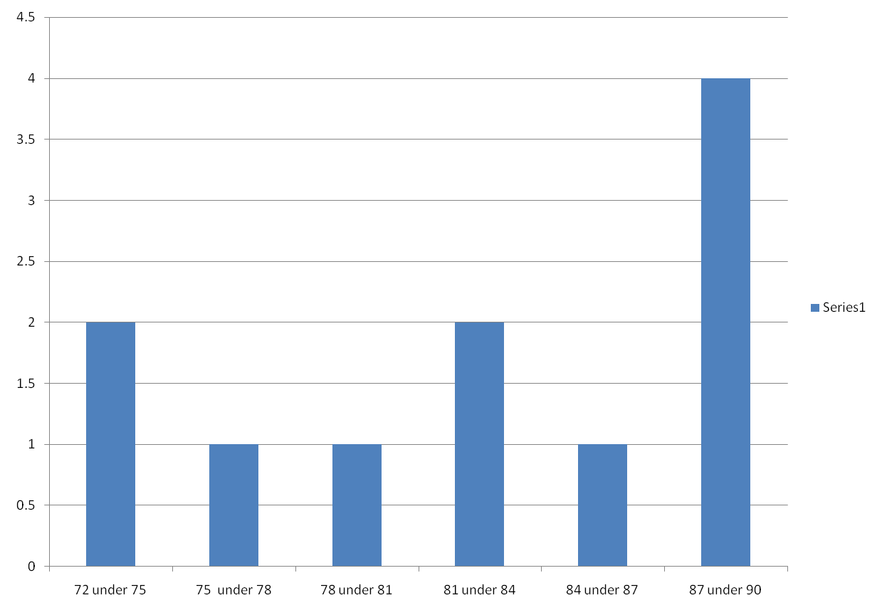

Slide 20
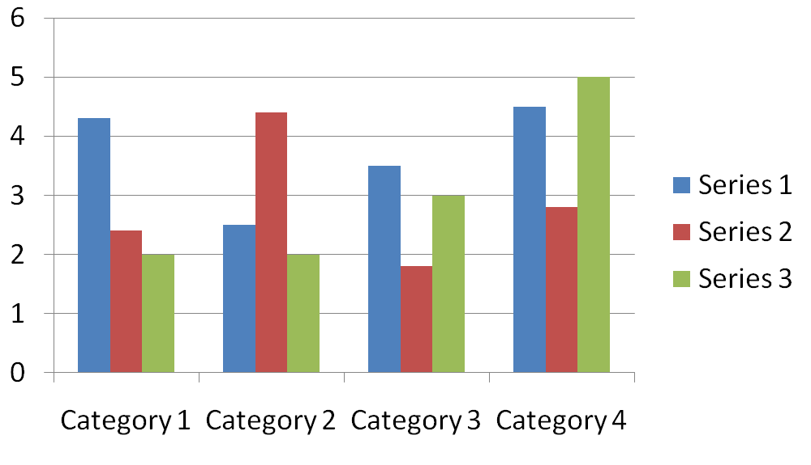
 | Series 1 | Series 2 | Series 3
Category 1 | 4.3 | 2.4 | 2
Category 2 | 2.5 | 4.4 | 2
Category 3 | 3.5 | 1.8 | 3
Category 4 | 4.5 | 2.8 | 5

Slide 21
Pie Chart
A pie chart is a circular representation of data in which a circle is divided into sectors , with area equal to the correspondent component. These sectors are called slices and represent the break down of the corresponding component.
The pie chart is the most common way of data presentation in today's business scenario. They are used for market share budget categories , time and resources allocation.
In the construction of the pie chart begins with determining the proportion of the component to the whole. Then each component proportion is multiplied by the 360 to get the correct number of degrees to represent each component.

Slide 22
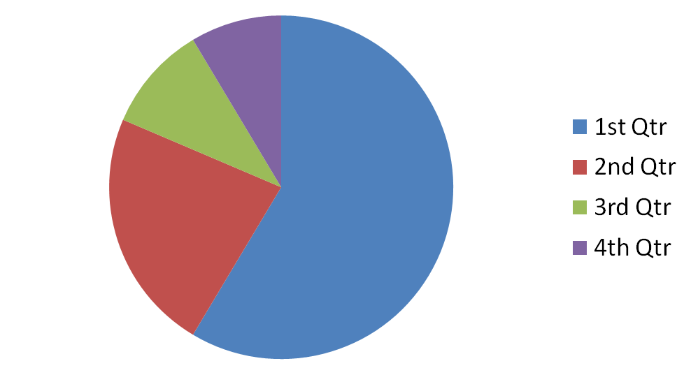
 | Sales (in thousand dollars) | Proportion | Proportion*360
1st Qtr | 8.2 | 0.585714 | 210.85704
2nd Qtr | 3.2 | 0.228571 | 82.28556
3rd Qtr | 1.4 | 0.1 | 36
4th Qtr | 1.2 | 0.08571 | 30.8556
Total | 14 | 0.99999999 | 360

Slide 23
Example
Construct a pie Chart for the break up of runs scored by YK Pathan
Break up | Scores | Proportion | Proportion *360
1 s | 19 | 0.18095 | 65.14
2 s | 6 | 0.057 | 20.52
4 s | 32 | 0.304 | 109.44
6 s | 48 | 0.457 | 164.57
Total | 105 | 0.9999999 | 359.61

Slide 24
